Slide 1
SECURE BITCOIN TRANSACTION USING BLOCKCHAIN
Nayana T.P
S4 MCA
Roll no:22

Slide 2
DESCRIPTION
As the internet is becoming more accessible and convenient, larger numbers of people and businesses are shifting towards digital transactions.
Digital payment methods are quicker, cheaper and much more efficient.
Cryptocurrencies like Bitcoin and Ethereum are among the most popular forms of digital payments.
Cryptocurrencies could be popularized in India as a viable option for digital currency.

Slide 3
RELEVANCE
It provides security and privacy.
Decentralized ledger to record all the transactions.
More convinient than going to bank.
Cryptocurrency charges fee at a minimum rate.

Slide 4
OBJECTIVES
To learn the impact of cryptocurrency.
To study the current status of cryptocurrency and the future it holds.

Slide 5
EXISTING SYSTEM
Hackers can easily hack credit card transactions by acquiring information of the card and account details while the transactions is processed by the payment gateways.
Transfers fees are determined based on the amount of each transaction and can be truly huge.
Invlovement of third party in credit card transaction.
Credit card companies get information about the
Consumers and therefore they violate user privacy.

Slide 6
PROPOSED SYSTEM
It is almost impossible to hack the litecoin network.
Cryptocurrency charges fee at a minimum rate.
With bitcoin transaction there is no need of intermediaries as payment is made within the users present in the bitcoin network.
In Bitcoin transaction there is no need to provide any kind of personal information or identification like name and address.

Slide 7
MODULES
Creating new wallet
Generating transaction
Signing the transaction
Create block
Mine block
Verify transaction
View user
Valid chain

Slide 8
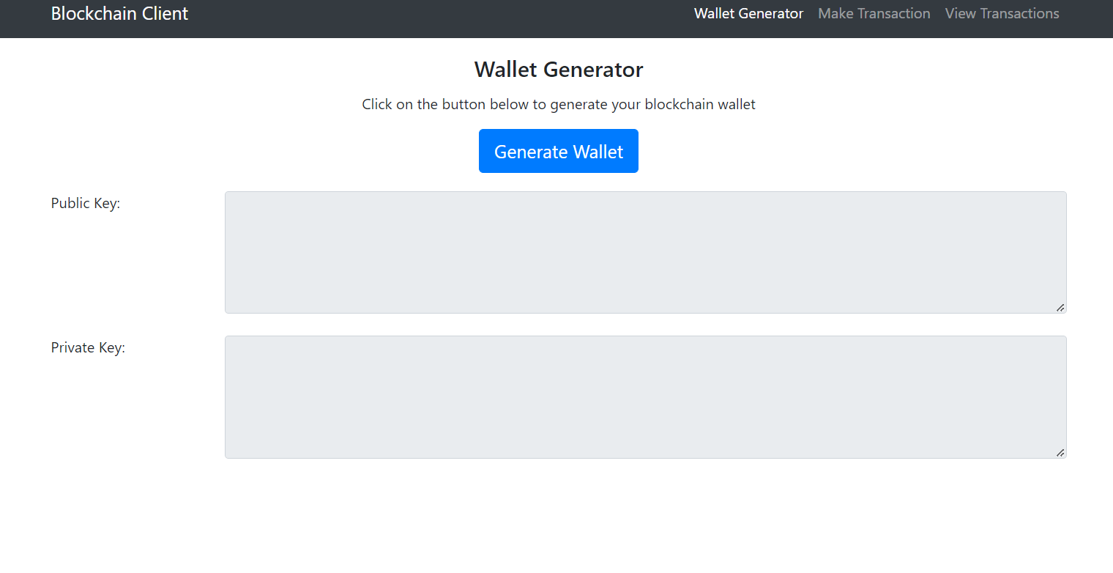
SCREENSHOTS

Slide 9
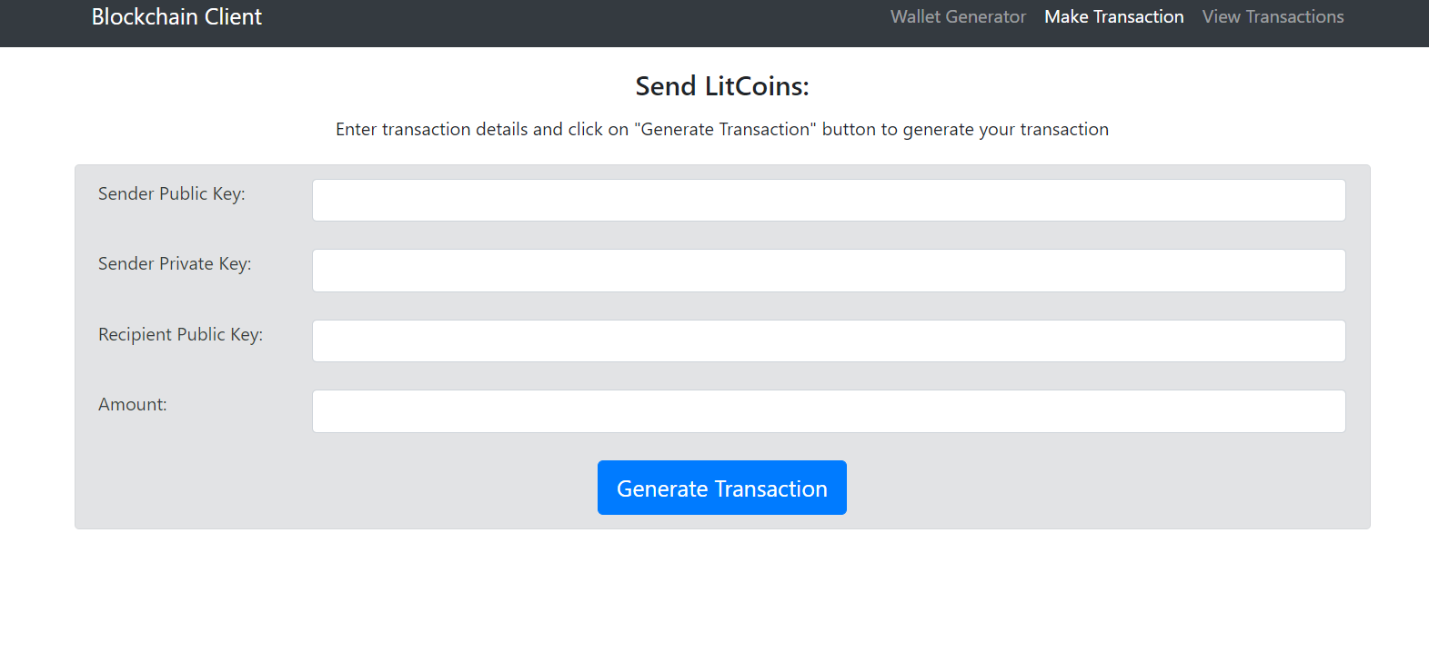

Slide 10
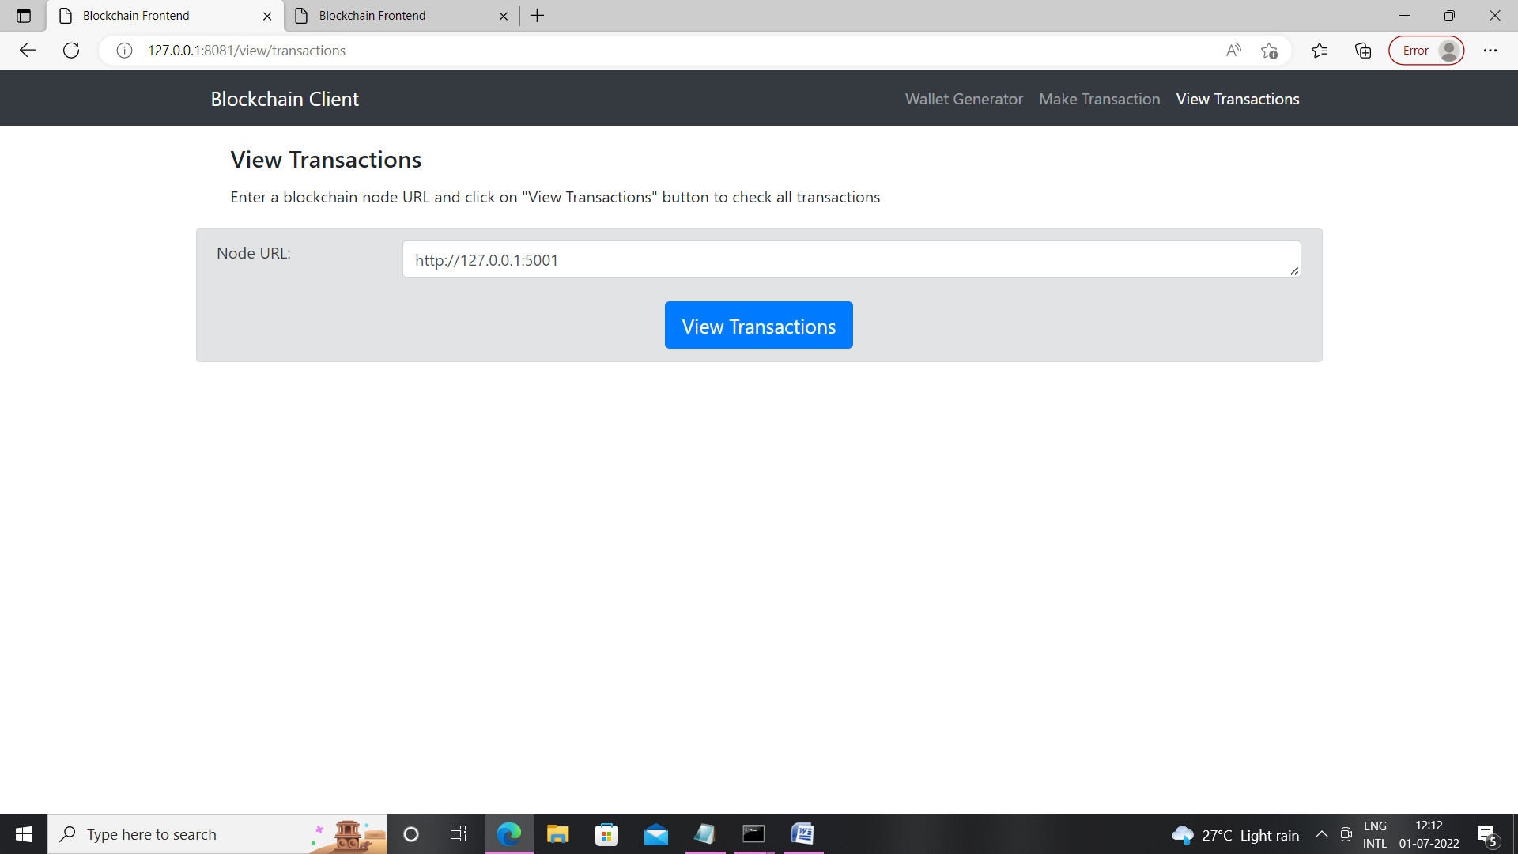

Slide 11
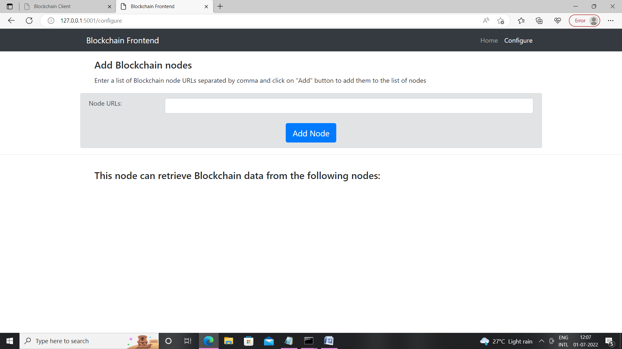

Slide 12
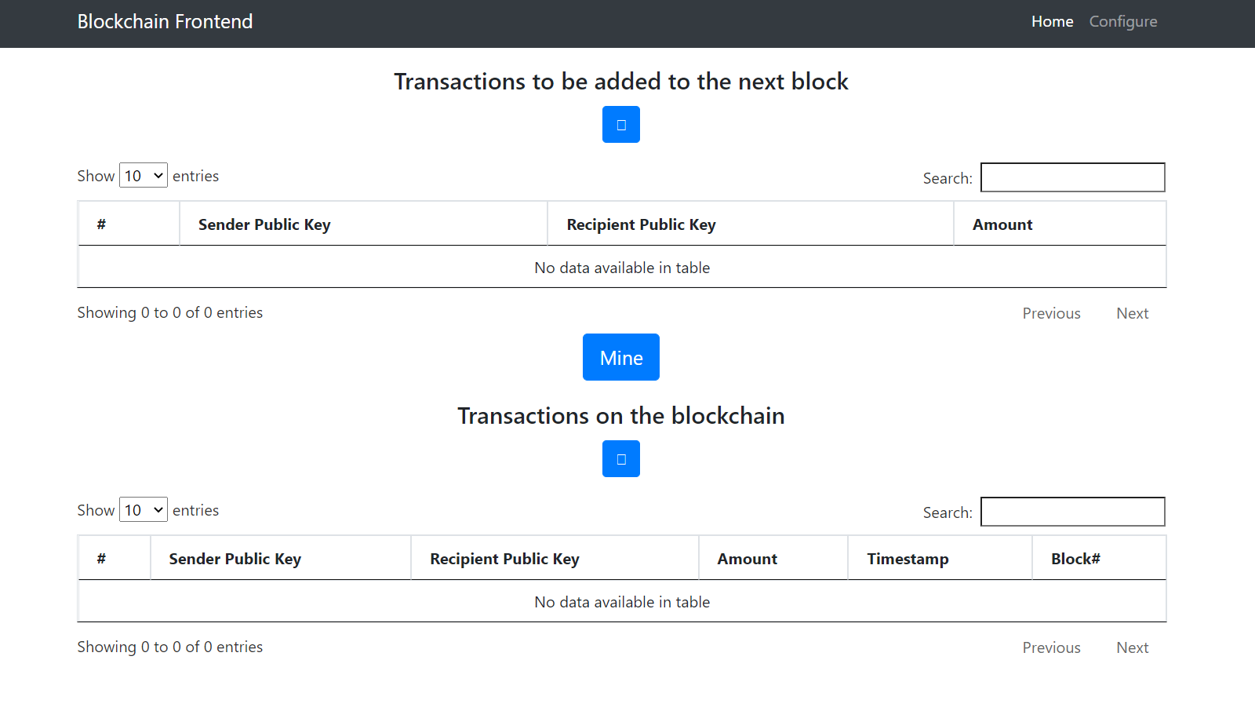

Slide 13
THANK YOU

